Slide 1
L.4 & October Vocabulary
Mrs. Blake’s 7th Grade ELA
October 2017

Slide 2
Monday, 10/2
Grab your Cheat Sheet packet so we can label L.4 (October’s Essential Standard) & October’s vocabulary. Put a star next to each one listed and write definitions.
Pages 8-10: context clues, prefixes, suffixes, and root words.
Pages 13-14: short story, novel, realistic fiction
Page 15: flashback and foreshadowing
Page 17: conflicts and point of view

Slide 3
Turn to page 13-14 in your Cheat Sheet and write these genre definitions.
Short story = contains < 15,000 words, one conflict, story elements, and is always fiction.
Novel = contains > 15,000 words, more than one conflict, story elements, and is always fiction.
Realistic fiction = A genre that is based on a completely made-up (fictional) story, but could be true because it is realistic (no crazy elements).

Slide 4
Turn to page 15 in your Cheat Sheet and write these definitions.
Foreshadowing = hints about something that will happen in the future.

Slide 5
Turn to page 15 in your Cheat Sheet and write these definitions.
Flashback = the plotline “flashes back” to something that already happened/the past.

Slide 6
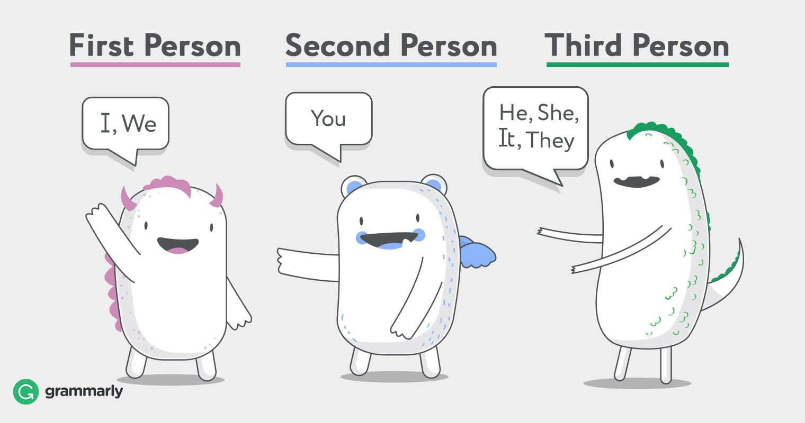
Turn to page 17 in your Cheat Sheet and write these definitions.
Point of view = this is the perspective through which a story is told. In other words, who tells the story? We will study four types of POV this year:
1st
2nd
3rd limited
3rd omniscient

Slide 7
Turn to page 17 in your Cheat Sheet and write these definitions.
Flocabulary

Slide 8
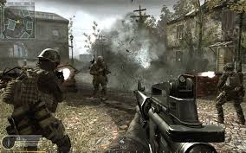
1st person point of view = a character tells the story (the character is also the narrator) using words like I, me, my, we, us…

Slide 9
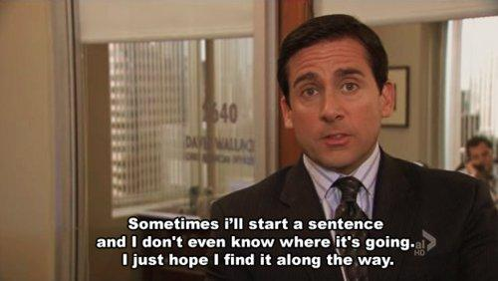
2nd person point of view = the narrator references the reader/viewer/audience. The word “you” is used.
Bubble Guppies

Slide 10
3rd person limited point of view = the narrator and reader only know as much as the character(s). The narrator is NOT a character. Words that are used include they, she, he...

Slide 11
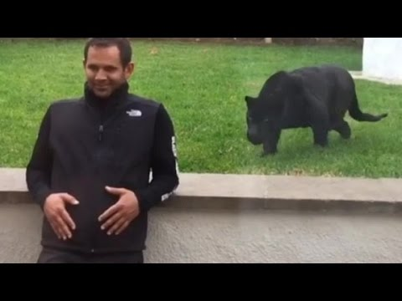
3rd person omniscient point of view = the narrator and reader know more than the character(s). The narrator is NOT a character. Words that are used include they, she, he...

Slide 12
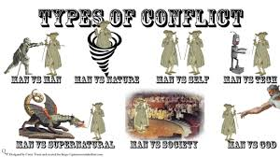
Turn to page 17 in your Cheat Sheet & write these definitions.
Conflict = the main problem . In other words the main obstacle that needs overcome. There are different types of conflict:

Slide 13
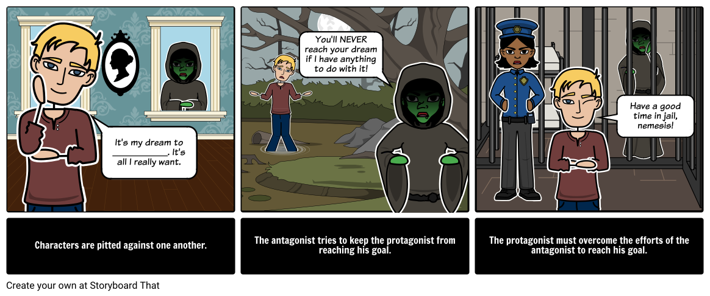
Turn to page 17 in your Cheat Sheet & write these definitions.
Man-v-man is an external conflict. Person against person.

Slide 14
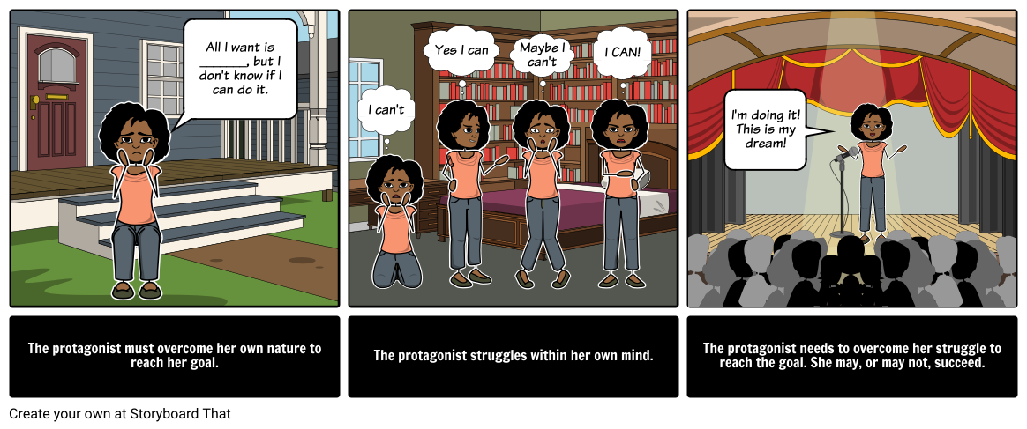
Turn to page 17 in your Cheat Sheet & write these definitions.
Man-v-self is an internal conflict. Person against regret, self-doubt, lack of confidence, etc.

Slide 15
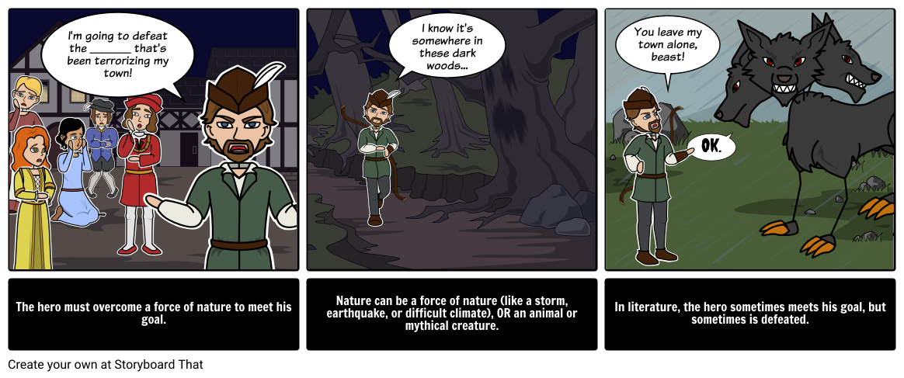
Turn to page 17 in your Cheat Sheet & write these definitions.
Man-v-nature is an external conflict. Person against weather, animals, death/illness, and forces out of human control.

Slide 16
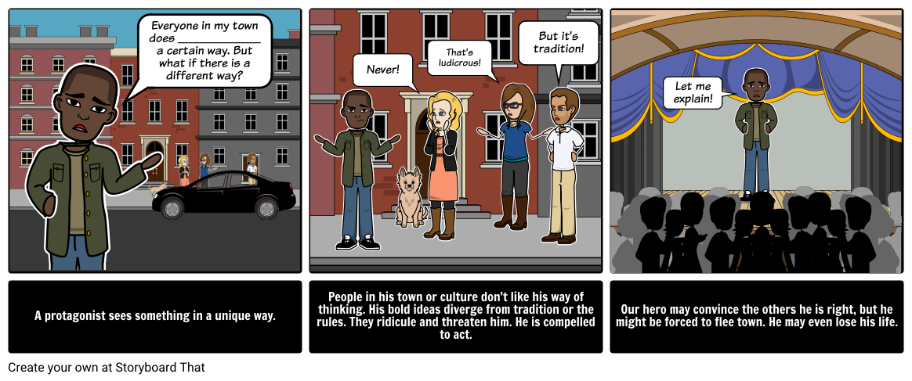
Turn to page 17 in your Cheat Sheet & write these definitions.
Man -v-society is an external conflict. Person against rules, “normal”, judges/ lawyers /police, etc.

Slide 17
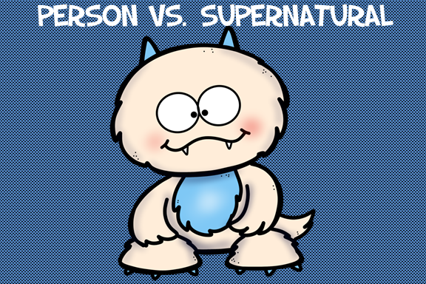
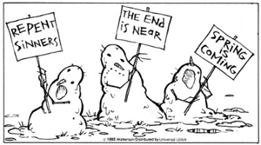
Turn to page 17 in your Cheat Sheet & write these definitions.
Man-v-supernatural or fate (destiny) is usually an external conflict, like ghosts, prophecies, religion, monsters… Sometimes these are separated.

Slide 18
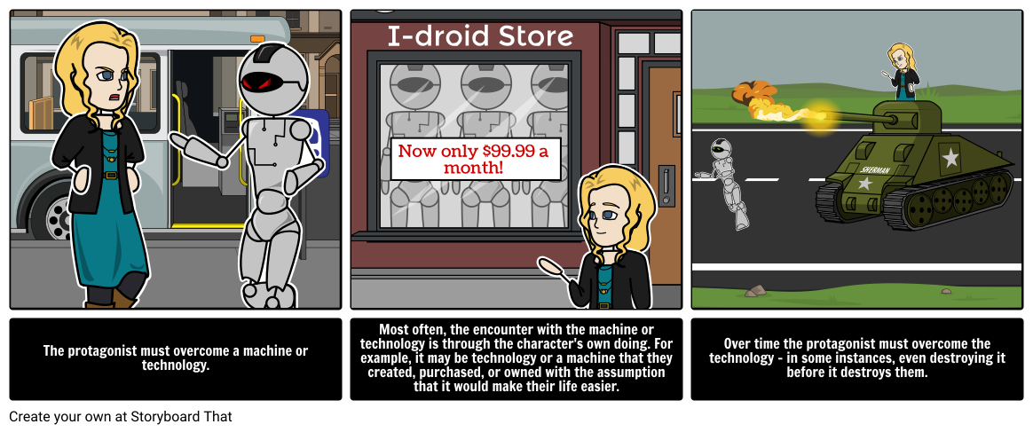
Turn to page 17 in your Cheat Sheet & write these definitions.
Man-v-technology (or machine) is an external conflict that includes science, inventions, time travel, not using technology correctly, and so on.

